Slide 1
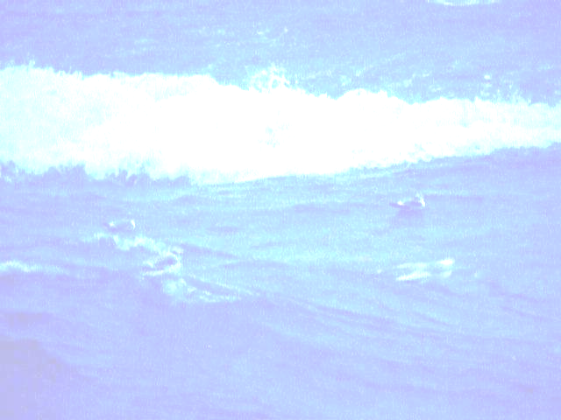
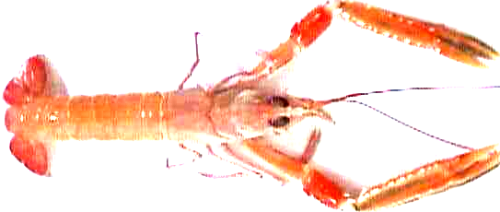

Ageing of Nephrops norvegicus
in Western Waters
IS Thompson, JE Whitmore, JP Hillis & J Carroll
Marine Institute, Dublin, Ireland.
Objective:
the age estimation of Nephrops norvegicus from around the Irish coast.
Methods:
Nephrops survey data and commercial catch data, were analysed using the fisheries mathematical model MULTIFAN (Otter Research Ltd, Canada, 1991).
MULTIFAN simultaneously analyses multiple length frequency distributions and provides maximum likelihood estimates for length at age.
User-set constraints are placed on the obvious modes within the length frequency distributions. The model can be modified to include varying standard deviations, seasonal growth and a correction factor to compensate for mesh selection in the first age group.
Provisional Results:
Length at age would appear to vary both temporally and spatially.
Sample lengths at age in August for male Nephrops, Western Irish Sea are given as -
  Age Group 0: 8mm
Age Group 1: 17mm
Age Group 2: 22mm
Age Group 3: 27mm
Age Group 4: 32mm
Age group 0
Age group 1
Age group 2
Age group 3
Age group 4
Frequency
40
30
20
10
8
17
25
33
Carapace Length (mm)
An example of MULTIFAN analysis of male Nephrops norvegicus length frequency distributions. user defined constraints on mean length.
Project partners are D.A.N.I., Northern Ireland; IEO, Spain and IFREMER, France.
This project is funded by the E.U (Ref.: DGXIV/1995/086).

